Slide 1
Professional Development Program Data Collection System (PDPDCS)
OFFICE of INDIAN EDUCATION (OIE),
Office of Elementary and Secondary Education (OESE)
Angela Hernandez-marshall, Oie
Karen schroll, Westat
Aaron Petrillo, Anlar
February 1, 2019

Slide 2
Training Agenda
OIE Welcome and Training Purposes
Review required actions for data submission
Demonstration of how to complete those actions in the PDPDCS
Address frequently asked questions about the PDPDCS
Understand the resources available to you and your participants
Notes:
Please type your questions directly into the chat box. Thank you!

Slide 3
OIE Welcome
Angela Hernandez-Marshall
Office of Indian Education
Notes:
Welcome all!
ANGELA, PLEASE INSERT UPDATE.

Slide 4
PDPDCS Purposes
Comply with regulatory requirement to track Participant training and payback information
(34 CFR 263.11)
Supplement annual performance report (APR) data, which will inform determination of your substantial progress continuation award decisions.
Repository for data used by the federal government to report overall performance of the Professional Development program
Notes:
ANGELA
Good morning everyone and thank you for joining us today. I want to take a moment to revisit the purposes of the PDPDCS, which you may recall us discussing during your fall project directors’ meeting last November.
First, you as the grantee are required to conduct a payback meeting with the participant to explain the costs of training and payback responsibilities following training, and obtain a signed payback agreement from each participant before the participant begins training.
Second, you have to report training costs for each Participant
Third you have to track the length of training for each participant
Finally, you’ll have to eventually report when a participant has exited the program with/or without program completion.
All of these data you will report in this collection system. Timely submission ensures:
You are achieving grant compliance
We have data to supplement the Annual Performance Report that you will be required to submit by April 3.

Slide 5

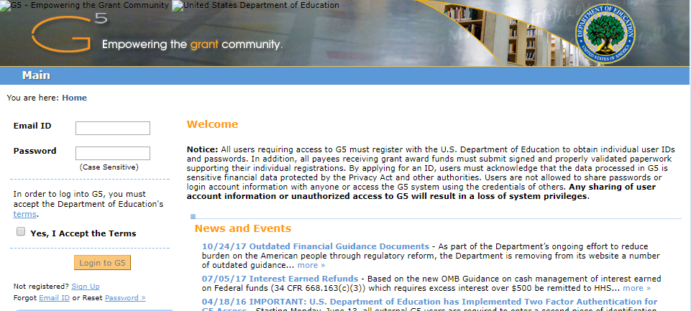
How is PDPDCS different from G5?
PDPDCS (https://pdp.ed.gov/oie)
ED Staff, grantees and Participants have access.
Where grantee submits participant training and payback information
Managed by OIE’s contracted staff (Anlar and Westat)
G5
(https://www.g5.gov)
ED Staff and grantees have access.
Where grantee can view grant funds draw-down activity
Where grantees will submit their APRs
Notes:
ANGELA
Good morning everyone and thank you for joining us today. I want to take a moment to revisit the purposes of the PDPDCS, which you may recall us discussing during your fall project directors’ meeting last November.
First, you as the grantee are required to conduct a payback meeting with the participant to explain the costs of training and payback responsibilities following training, and obtain a signed payback agreement from each participant before the participant begins training.
Second, you have to report training costs for each Participant
Third you have to track the length of training for each participant
Finally, you’ll have to eventually report when a participant has exited the program with/or without program completion.
All of these data you will report in this collection system. Timely submission ensures:
You are achieving grant compliance
We have data to supplement the Annual Performance Report that you will be required to submit by April 30.

Slide 6
Actions to complete in the PDPDCS
Notes:
Transition to grantees’ to do list of all the activities they should be completing by the deadline of April 6th.

Slide 7
Activities to Complete in the PDPDCS
1
Log into the PDPDCS and assign a secondary user
Add participants
Upload Service Payback Agreements
Review and submit all data by March 29th deadline
2
3
4

Slide 8
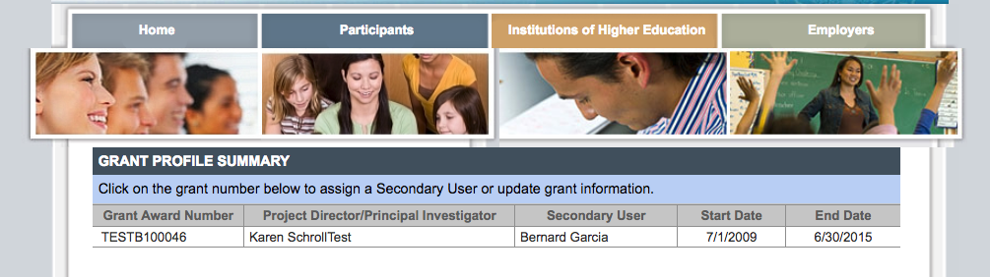
Step : Log into the PDPDCS
1
Log in and review the secondary users assigned to your grant.
Notes:
Set-up a secondary user if you want someone else with the grant to be able to enter participant information. However, the Project Director is held responsible for all data entries.
Each person should have a unique log in to the system. Do not share your password with anyone – add a secondary user! PDPDCS is governed by Federal security regulations; sharing your password violates those Federal security regulations.
Only two people per grant are permitted access.
Demo how to add or change a secondary user.

Slide 9
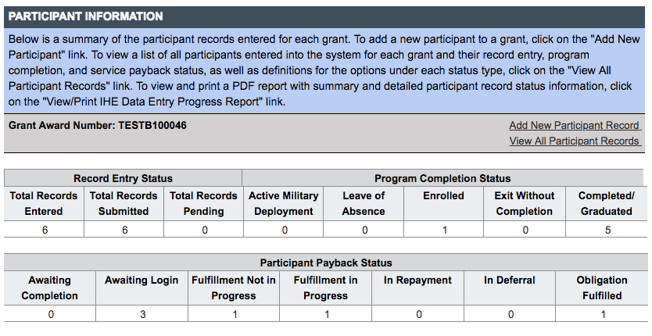
Step : Add new participants
2
Add records for new participants not already in the PDPDCS.
Notes:
You should add new participant records for participants not already in the system who have been enrolled in the program for 30 days or more. (Demo clicking on “Add New Participant Record” entering SSN and getting blank Participant Record to complete.)

Slide 10
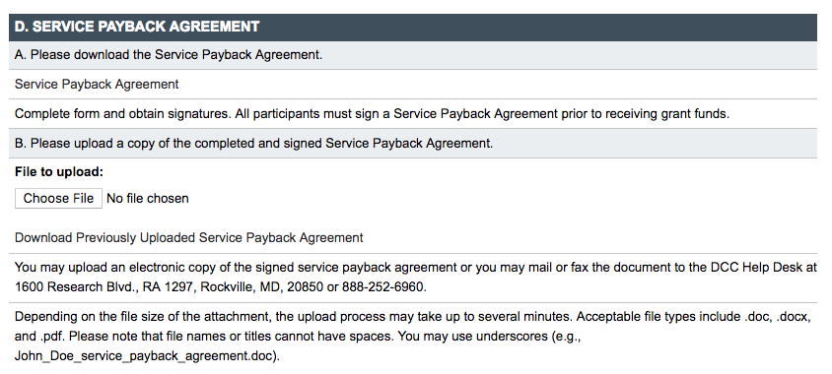
Step : Upload Service Payback Agreements
3
Notes:
Demo opening the record of a participant already entered.

Slide 11
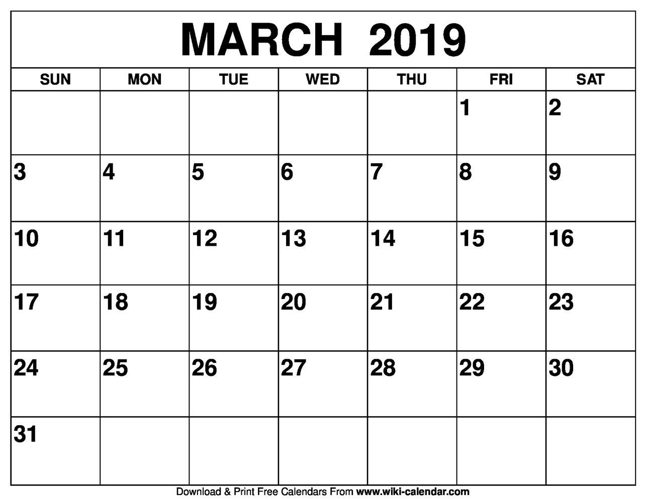
Step : Submit Data for ALL Participants by the Deadline
4
Notes:
Make sure by the deadline of March 29, 2019 you enter/update and submit records for all currently enrolled participants and participants who have graduated or exited prior to completion since your last update to the system. You do not need to update records for participants you have already submitted as graduated or exited prior to completion. In fact, once you have submitted a record for a participant with a status of graduated/completed or exited prior to completion you will not be able to edit the record. If you need to make any changes to these records please contact the Help Desk.
Make sure you have no participants in a pending status by the deadline. Participants cannot be left in a pending status for more than 30 days.
All noncompliant grantees will be reported to OSEP. Project Officers will contact then be contacting each project director of grants that have not submitted all participant data to determine what barriers are preventing the grantee from submitting their participant data as required and in a timely manner.
According to section 75.217(d)(3)(ii), the Secretary can consider the failure to submit participant data in a timely fashion in determining your project’s ability to obtain future grants from OIE or under any other Department program.

Slide 12
Timely Submission
  Federal Regulations:
  According to 34 CFR 75.253(a)(3), the timely submission of this report is one of the factors that the Secretary will consider in determining whether to continue your project's funding for next fiscal year.
  According to section 75.217(d)(3)(ii), the Secretary can consider the failure to submit participant data in a timely fashion in determining your project’s ability to obtain future grants from the Office of Indian Education or under any other Department program.
Notes:
As an OSEP grantee, you are required to submit data for continuation funding and for other reporting, such as performance measures and service obligation. Submitting data on time or the failure to submit data can be considered in determining your ability to obtain future grants not only from OSEP by from other Department programs.
As an OIE grantee, you are required to submit data for continuation funding and for other reporting, such as performance measures and service obligation. Failure to submit data or submit data on time can be considered in determining your ability to obtain future grants not only from OIE by from other Department programs.

Slide 13
PDPDCS Demonstration
Notes:
Transition to Karen’s demonstration of the PDPDCS.

Slide 14
Frequently Asked Questions
Notes:
Transition to frequently asked questions that we receive from grantees about using the PDPDCS, submitting data and other related requirements.

Slide 15

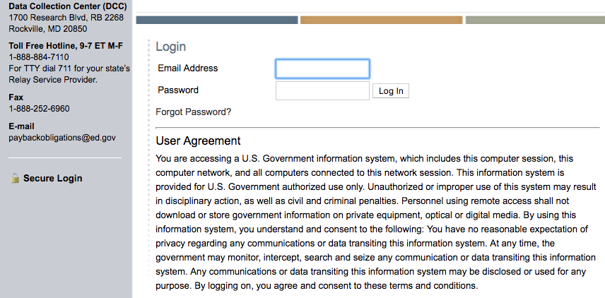
How do I reset my password?
Use the “Forgot Password” link on the login page.
Notes:
**Coming soon: Multi-Factor Authentication**

Slide 16

Why aren’t I (or my participants) receiving emails from the PDPDCS?
To ensure you and your participants receive all system notifications:
  Add paybackobligations@ed.gov to your contact list
  Check your email settings to be sure emails from this account are not marked as spam
  Enter a non-IHE email address for each participant

Slide 17
Why should I add a secondary user?
Project Directors are responsible for all data entries, however secondary users are permitted access to the PDPDCS.
Only two people per grant are permitted access.
Secondary users are given a unique login allowing the to enter participant information.
Secondary users also receive PDPDCS reminder emails and notifications.

Slide 18
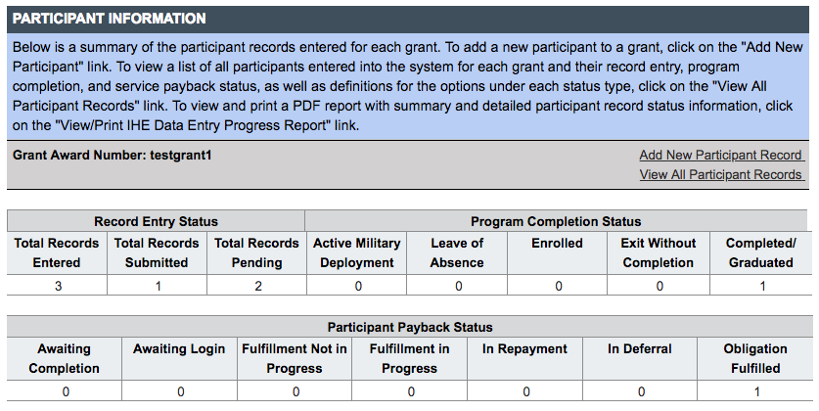
How do I know if my participants have logged into the PDPDCS?
Notes:
Remind participants to login to PDPDCS at least every 6 months to review and update contact and training information and enter employment.
You should monitor the service obligation status of all participants in your program using the summary tables that display counts of participants in each service obligation status. Your support will help us ensure OIE has the data it needs to provide reporting on Program Performance Measures and service obligation results to Federal government authorities.

Slide 19
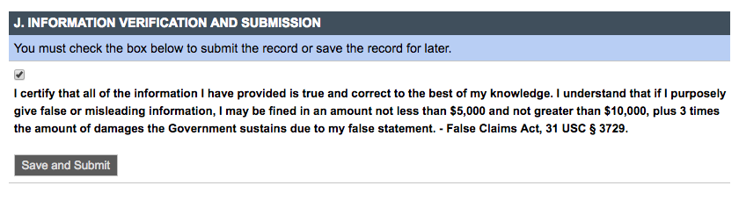
My participant is still enrolled. Should I submit his/her record?
Notes:
Yes, you should submit all participant records including participants who are still enrolled within 30 days of entering the participant’s record in the system. You will be able to edit your participant records as long as the participant has a program status of enrolled.

Slide 20
Service Payback Agreement Questions
When do participants and grantees sign the agreement? | Upon officially enrolling in the grant supported program, sign and complete a service payback agreement.
When do I upload the agreement? | Upload within 30 days of the participant’s enrollment.
What should I check prior to uploading? | Ensure you are using the correct version (OMB Control Number: 1810-0698 Expiration: 5/31/2019), All pages are included, All entries are written legibly and the forms are signed by both the participant and grantee, and Social security numbers are redacted.

Slide 21
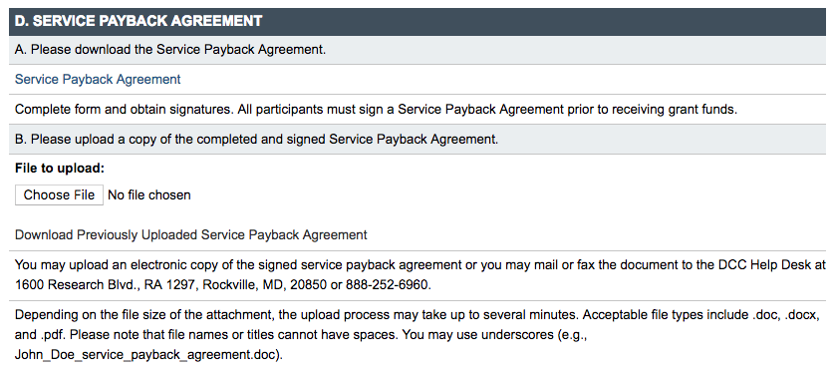
Service Payback Agreement Questions Continued
Grantees will not be able to submit participant records without uploading the service payback agreement.
Grantees should review to ensure the participant’s SSN is redacted.
Grantees may be responsible for repayment of grant funds in cases where they do not have a valid signed agreement for a participant.
Notes:
Participants’ names should match what’s in the DCS and SSNs should be redacted on the PSA and EC after you enter the SSN in the system.

Slide 22

What do I need to tell my participants about their payback obligation?
Clearly explain to your participants before they accept funding, that participants are required to:
Log into the PDPDCS and submit eligible employment information to receive credit towards their payback obligation
Update employment information annually
Participants may begin fulfilling their obligation through service once they have completed or exited the program
Notes:
In addition to the PSAs, you must disseminate to participants copies of the current regulations, 34 CFR part 263, and the frequently asked questions (FAQs). Participants also have certain requirements they must fulfill if they accept funding. Please explain clearly to your participants before they agree to accept funding their payback obligation requirements and continue to remind participants throughout the program about the requirements and that they will need to submit employment information.

Slide 23
What do I need to tell my participants about their payback obligation?
Participants who do not submit eligible employment information verified by their employer by the time their payback obligation must be fulfilled are not in compliance and will be referred to Accounts Receivable and Bank Management Division (ARBMD) for repayment.

Slide 24
How Does OIE Use the Data that Grantees Report?
Grantee data is used to:
Support program performance measures
Track payback obligation requirements of participants and report to Accounts Receivable and Bank Management Division (ARBMD) for cash payback when participants do not comply with payback obligation regulations
Inform for internal reports, grant monitoring, and program improvement activities

Slide 25
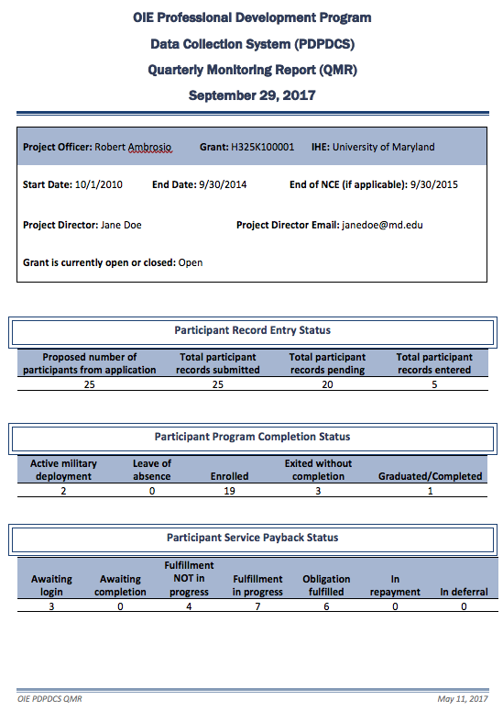
How Does OIE Use the Data that Grantees Report? (Continued)
Quarterly Monitoring Reports (QMR)
  Assists OIE Project Officers in monitoring the status of participants enrolled in each preparation program funded by OIE

Slide 26
What are some lessons learned from prior years?
  Use the OMB cleared Participant agreement form available on PDPDCS (or your agreement may not be valid)
  Ensure your Participants are in “Submitted” status or they will be deleted.
  Ensure that the same number of participants you placed in “Submitted” status in PDPDCS is what you report in your APR.
  Ask your Participants to log in to review the data you have entered.
Notes:
ANGELA

Slide 27
When do I need to update my participant’s records?
Notes:
Make sure by the deadline of March 30, 2018 you enter/update and submit records for all currently enrolled participants and participants who have graduated or exited prior to completion since your last update to the system. You do not need to update records for participants you have already submitted as graduated or exited prior to completion. In fact, once you have submitted a record for a participant with a status of graduated/completed or exited prior to completion you will not be able to edit the record. If you need to make any changes to these records please contact the Help Desk.
Make sure you have no participants in a pending status by the deadline. Participants cannot be left in a pending status for more than 30 days.
According to section 75.217(d)(3)(ii), the Secretary can consider the failure to submit participant data in a timely fashion in determining your project’s ability to obtain future grants from OIE or under any other Department program.

Slide 28

PD Grantee Deadlines
PDPDCS (https://pdp.ed.gov/oie)
Participant records submission deadline:
March 29, 2019
G5
(https://www.g5.gov)
APR submission deadline:
April 30, 2019
Notes:
ANGELA:
[Repeat deadlines for records vs. APR]

Slide 29
Resources and Support

Slide 30
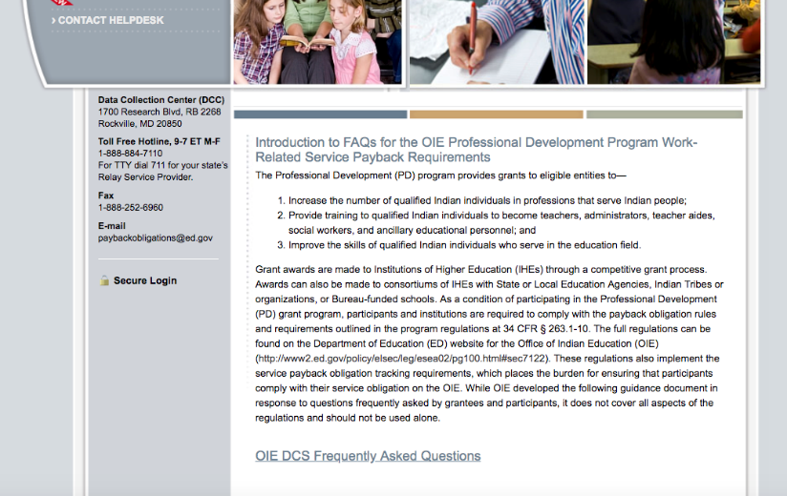
PDPDCS Resources
PDPDCS resources include:
An archived recording of this webinar will be made available (https://pdp.ed.gov/OIE/Home/Agreements)
PDPDCS Frequently
Asked Questions
(https://pdp.ed.gov/OIE/Home/faq/)
Notes:
A recording of this webinar will be made available on the website for grantees and staff who missed this training or need a refresher. In addition, on the website you can find responses to questions frequently asked by grantees, participants, and employers regarding program regulations and requirements pertaining to the grant funding, links to service payback regulations and service payback agreements. Our Help Desk is available M-F 8 am to 8pm EST via phone or email.

Slide 31
PDPDCS Resources
Payback obligation resources for grantees and participants:
Service Payback Agreements (https://pdp.ed.gov/OIE/Home/Regulation)
2015 Payback Obligation Regulations (https://pdp.ed.gov/OIE/Content/pdf/PD_Program_Regulations.pdf)
PDPDCS Frequently Asked Questions available at: (https://pdp.ed.gov/OIE/Content/pdf/OIE_DCS_FAQs.pdf)

Slide 32
Questions and Discussion
More questions?
PDPDCS Help Desk
  Support available from 8 am to 8 pm EST
  Monday through Friday
  1-888-884-7110
  For TTY dial 711 for your state’s Relay Service Provider
  paybackobligations@ed.gov

Slide 33
Feedback Questionnaire
Please provide feedback on today’s training to improve our support of grantees and participants:
https://www.surveymonkey.com/r/K938WPL

